Slide 1
Functional Dependencies and Normalization
Nindi Pigitha

Slide 2
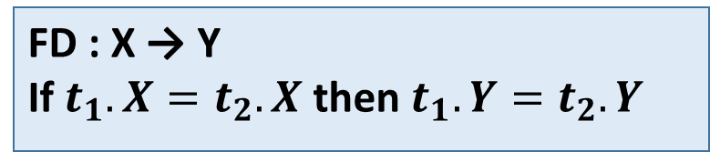
Functional Dependency
FD : X → Y
If $t_{1}.X=t_{2}.X$ then $t_{1}.Y=t_{2}.Y$
X | Y
1 | 1
2 | 1
3 | 2
Jika kita tahu nilai X maka kita bisa dapat nilai Y
Jika X unik, maka X → Y pasti FD
X dan Y bisa lebih dari 1 atribut
X | Y
1 | 1
2 | 1
3 | 2
2 | 3

Slide 3
Functional Dependency
RNo | Name | Scores | Dept | Course
1 | A | 78 | CS | C1
2 | B | 60 | DS | C1
3 | A | 78 | CS | C2
4 | B | 60 | DS | C3
5 | C | 80 | IT | C3
6 | D | 80 | SA | C2
RNo → Name
Name → RNo
RNo → Scores
Dept → Course
Name → Course
(RNo, Name) → Scores
(Name, Scores) → (Dept, Course)
✅
❌
✅
❌
❌
✅
❌

Slide 4
Need of Normalization in DBMS
Insertion Anomaly
Apa terjadi jika terdapat departemen baru bernama MNM?
Updation Anomaly
Apa yang terjadi jika Departemen CSE dipindahkan ke Gedung B3 room 301?
SID | Sname | Credits | DeptName | Building | Room_No
1 | Rahul | 5 | CSE | B1 | 101
2 | Jiya | 8 | CSE | B1 | 101
3 | Jenny | 9 | FDG | B2 | 201
4 | Elita | 9 | CVL | B2 | 115
5 | Vania | 7 | CSE | B1 | 101
6 | Tanaka | 7 | CVL | B2 | 115
Deletion Anomaly
Bagaimana jika departemen MNM hanya terdapat 1 mahasiswa dan mahasiswa tersebut ingin dihapus dari database?

Slide 5
Need of Normalization in DBMS
SID | Sname | Credits | DeptName
1 | Rahul | 5 | CSE
2 | Jiya | 8 | CSE
3 | Jenny | 9 | FDG
4 | Elita | 9 | CVL
5 | Vania | 7 | ECE
6 | Tanaka | 7 | CVL
DeptName | Building | Room_No
CSE | B1 | 101
FDG | B2 | 201
CVL | B2 | 115

Slide 6
Normalization
Normal Form | Test | Remedy (Normalization)
First (1NF) | Relation should have no composite and multivalued attributes or nested relations. | Form new relations for each multivalued attribute or nested relation.
Second (2NF) | For relations where primary key contains multiple attributes, no nonkey attribute should be functionally dependent on a part of the primary key. | Decompose set up a new relation for each partial key with iand ts dependent attribute(s). Make sure to keep a relation with the original primary key and any attributes that are fully functionally dependent on it.
Third (3NF) | Relation should not have a nonkey attribute functionally determined by another nonkey attribute (or by a set of nonkey attributes). That is, there should be no transitive dependency of a nonkey attribute on the primary key. | Decompose and set up a relation that includes the nonkey attribute(s) that functionally determine(s) other nonkey attribute(s).

Slide 7
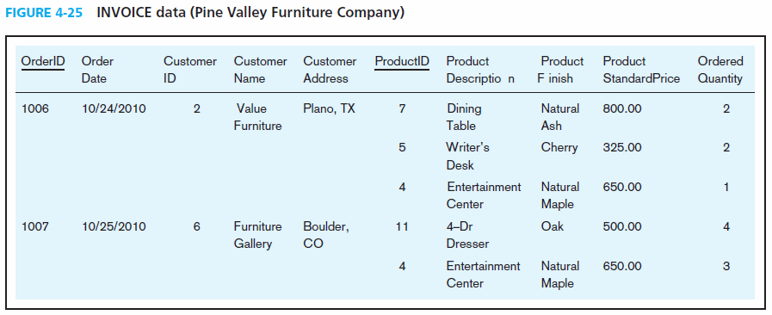


1NF

Slide 8
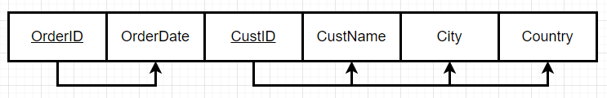
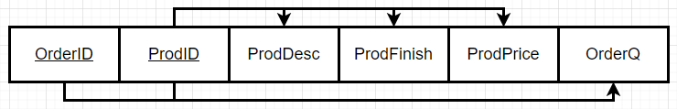

2NF
3NF

Slide 9
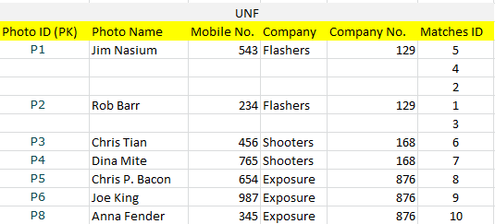

Slide 10
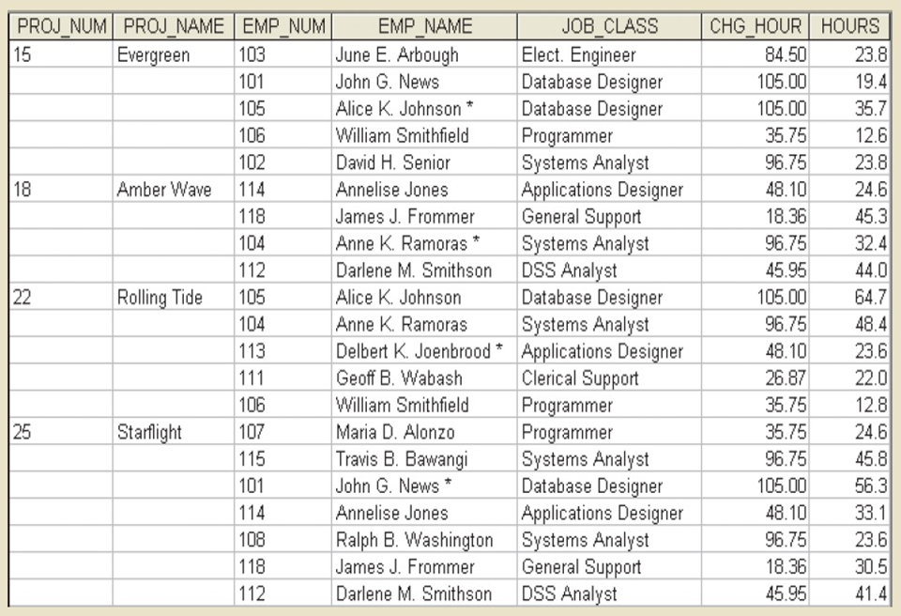

Slide 11
